Slide 1
Guarding the Guardians: Detecting Bias and Underlying Agendas in Environmental Fact-checking Using Machine Learning Approaches
Project Presentation – Team I
Jean Marc Baquero - h12543815
Grégoire Bouvier - h12543344
2026

Slide 2
Existing Literature (1)
The Data Challenge in Misinformation Detection: Source Reputation vs. Content Veracity (2018)
Fatemeh Torabi Asr and Maite Taboada
Big Data and quality data for fake news and misinformation detection (2019)
Fatemeh Torabi Asr and Maite Taboada
A Comparison and Critical Reflection of Information Disorder Detection Techniques (2026)
Mark Nicolas Gruensteidl and Sabrina Kirrane
Notes:
STATE OF THE ART: How have others tried to address this problem? You should summarize the existing literature putting a specific focus on the works that are closest to yours.

Slide 3
Existing Literature (2)
The Data Challenge in Misinformation Detection: Source Reputation vs. Content Veracity (2018)
Objective: To determine if models learn a publisher's writing style versus true deceptive cues by testing cross-domain generalization on individually labeled articles.
Methodology | Datasets | Main Findings
SVM classifier using unigram TF-IDF features | Rashkin et al. (reputation-based), Rubin et al. (satire), BuzzFeedUS, and Snopes312 | Model performance is heavily dependent on topic distribution. Focused topics make detection more difficult (e.g.: elections).

Slide 4
Existing Literature (3)
Big Data and quality data for fake news and misinformation detection (2019)
Objective: To review available datasets, identify gaps and imbalances via topic modeling, and advocate for higher-quality, reliably labeled "Big Data" for NLP system.
Methodology | Datasets | Main Findings
Topic modeling using Latent Dirichlet Allocation (LDA) to map topic density | MisInfoText repository (BuzzFeed, Snopes, Emergent) | A major challenge exists due to a lack of quality/balanced data (Technology and economy topics are often underrepresented). Topic variety is essential to prevent models from learning vocabulary biases.

Slide 5
Existing Literature (4)
A Comparison and Critical Reflection of Information Disorder Detection Techniques (2026)
Objective: To evaluate the state-of-the-art models in detection through cross-data, and cross-model analysis, with a focus on European contextual data.
Methodology | Datasets | Main Findings
Comparison of BERT, RoBERTa, ALBERT, DeBERTa, and Longformer models | ISOT, BuzzFeed, LIAR, NELA-GT, and MENA (Mixed European News Articles) | RoBERTa-1 and Longformer are the most effective models. Domain-specific fine-tuning significantly improves model robustness.

Slide 6
Research Methodology
Which datasets / data sources will you work with?
Misinformation_detection (2018) on GitHub: https://github.com/sfu-discourse-lab/Misinformation_detection/blob/master/README.md
IDD-Resources (2025) on GitHub: https://github.com/mangrue/IDD-Resources
FakeNewsCorpus (2020) on GitHub: https://github.com/several27/FakeNewsCorpus
Which tools/algorithms/models/metrics do you plan to employ?
Latent Dirichlet Allocation (LDA)
BERTopic: https://maartengr.github.io/BERTopic/index.html

Slide 7
Workplan
Tasks and Milestones:
Curate a sub-dataset with environment articles - 29.5.2026.
Sub-dataset des 3 datasets – clean-up >JM
Use LDA, BERTopic to map subjects of contention – 5.6.2026
Trouver les sujets de contentieux >BG
Appliquer les modèles pour trouver les % de sujets contentieux dans nos datasets >JM
Compare to wider statistics to identify bias/blind-spots - 5.6.2026.
Implement the model and map the topic density discrepancies on fact-checkers and general media - 12.6.2026.
Trouver les pourcentages de sujets environnementaux dans les données réelles → google Analytics / source de presse spécialisée >BG
Create Tags and add them to the dataset - 19.6.2026
Implémentation -> comment intégrer les tags dans le dataset ?
Generalization for other topics and other contextual flags - 26.6.2026.

Slide 8
TODO
BACKGROUND AND RATIONALE: You should argue why your project is relevant from a societal or industrial perspective. –G
RESEARCH QUESTION(S): You should provide an overview of your research questions. –G
RESULTS: Demonstrate your research results. This can be done via slides, talking through your notebooks, and/or a demo of your project. –JM DONE
DISCUSSION: The goal is to show off your project results in the best light possible. Be ready to answer questions about the approach and results. For instance, why did you choose dataset/model/tool X? Why do the results differ depending on dataset/model/tool X? What the the limitations of your project? .-JM DONE

Slide 9
The Societal & Industrial Threat of Climate Misinformation
Political & Industrial Impact
Policy Obstruction: Direct weakening of climate actions, regulatory frameworks (e.g., EPA), and international compliance (e.g., Paris Agreement) (Farrell et al.).
Corporate Greenwashing: Diminished stakeholder pressure creates a "cultural acceptance" of harmful behaviors, increasing social costs and compliance violations (Afzali et al.).
Global Priority: Ranked as the #1 global risk for the next 2 years by the World Economic Forum (Global Risks Report 2024).
Epistemic & Psychological Erosion
Erosion of "Epistemic Welfare": Fosters "strategic ignorance" and alternative facts, destroying public trust in scientific research and academic institutions (Essien, Farrell et al.).
Social Polarization: Exploits pre-existing biases, creating echo chambers and motivated reasoning where emotions (fear, anger) override empirical data (Treen et al., Essien).

Slide 10

The Societal & Industrial Threat of Climate Misinformation

Slide 11
Guarding the Guardians – The Power & Bias of Fact-Checkers
The Institutional Role of Fact-Checkers
The Democratic Watchdog: Tasked with the systematic assessment of claims to hold leaders accountable and reinforce journalistic authority (Walter et al., Ferracioli et al.).
Platform Gatekeepers: They act as the ultimate arbiters of truth for major digital infrastructures and algorithmic feeds.
The Neutrality Dilemma
The Credibility Debate: Increasingly criticized for "motivated reasoning", selective targeting, and adversarial positioning (Walter et al., Ferracioli et al.).
The Political Fine Line: In highly polarized environments (like climate discourse), the boundary between objective neutrality and ideological engagement is blurred.
Our Focus: If fact-checkers serve as the training data for Automated Misinformation Detectors, identifying their systematic selection biases is critical for algorithmic governance.

Slide 12
Research Question
Main Research Question:
Using machine learning methods to calculate topic density, how does the comparison of the human-verified datasets used to train the Fake News detector algorithms against a diverse reference corpus reveal systematic selection bias in specific contentious environmental sectors?
Sub1: What are the core contentious environmental sectors and underlying socio-economic interests mapped within online climate discourse, and how can they be categorized for algorithmic bias detection?
Sub2: How do advanced embedding and topic modeling techniques (e.g., BERTopic or Transformer representations) compare in quantifying topic density discrepancies between fact-checked data and general media?
Sub3: How can this methodology be operationalized over time and generalized to offer insights in other important news topics, such as health, politics, technology, etc. to practically surive the continuous introduction of new topics/narratives?

Slide 13
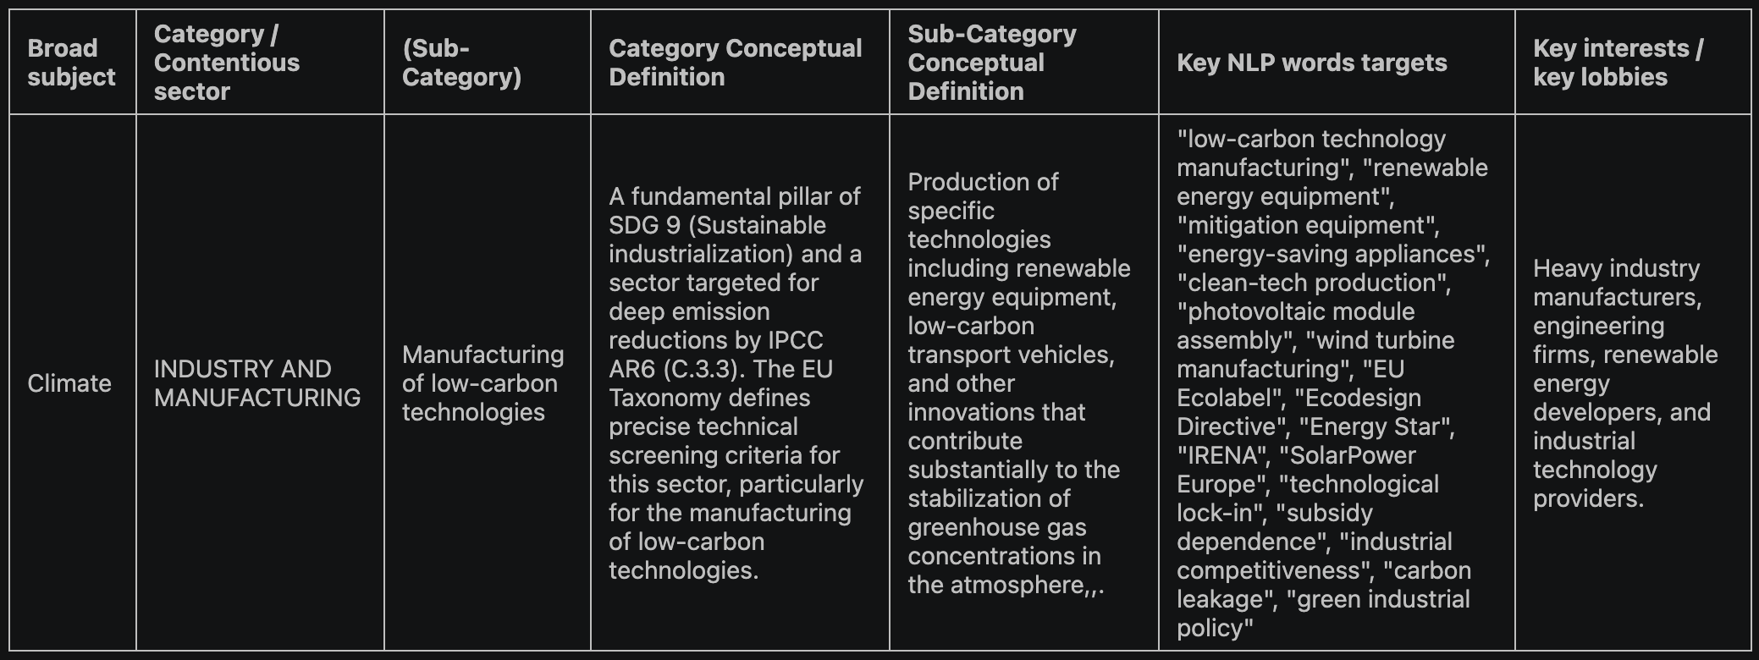
Methodology for mapping contentious subjects
Gathering references:
Selection of texts from the UN, IPCC, IPBES, and EU
Define an architecture of classification
Establishing a coding structure
Define categories and keywords with LLM (NotebookLM)
Establishing prompts with Gemini 3.1 Pro, then run them into NotebookLM
Notes:
STATE OF THE ART: How have others tried to address this problem? You should summarize the existing literature putting a specific focus on the works that are closest to yours.

Slide 14
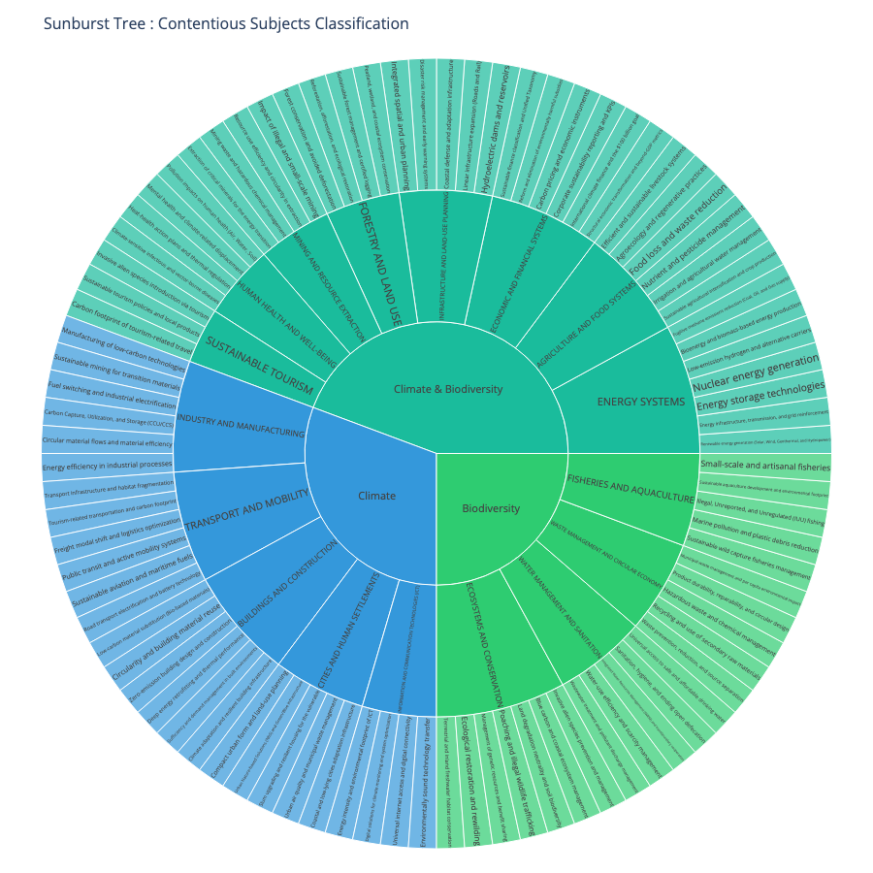
Map of environmental contentious subjects
Notes:
STATE OF THE ART: How have others tried to address this problem? You should summarize the existing literature putting a specific focus on the works that are closest to yours.

Slide 15
Results
2 Datasets
2 Machine learning tools
2 Uses for BERTopic
2 Uses for CorEx

Slide 16
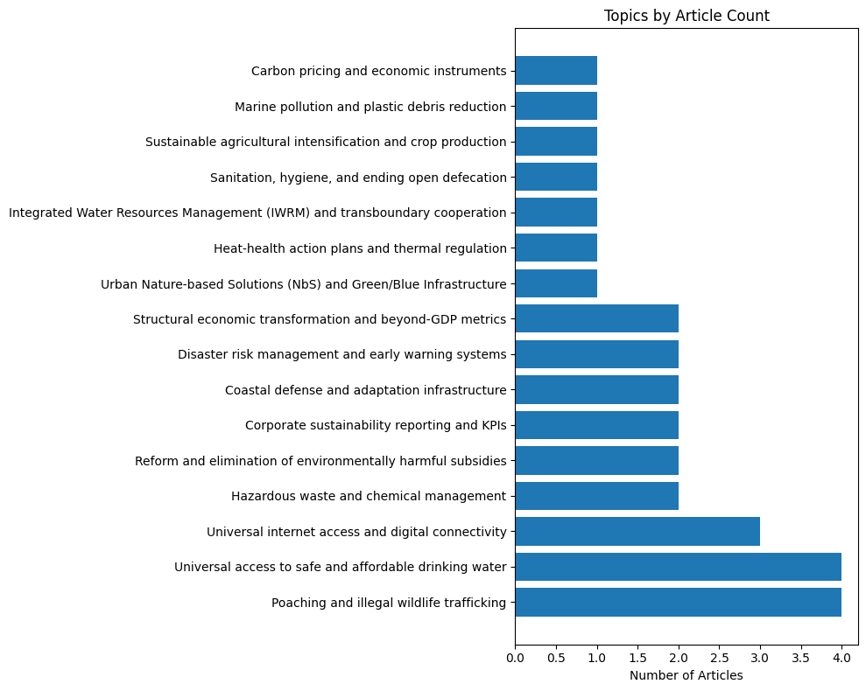
BERTopic directed model
Zeroshot method
Seed: Topics from taxonomy
Import Buzzfeed dataset
Remove stop words
N-gram range (1,2)
Min_df 2
Settings for model fitting
Min Topic Size 5
Min Similarity 0.3
Training
Inspecting non-outliers
Visualizing

Slide 17
BERTopic directed model
Zeroshot method
Good
Simplicity
Quick results
Bad
Only themes
No keywords
BERT choices

Slide 18
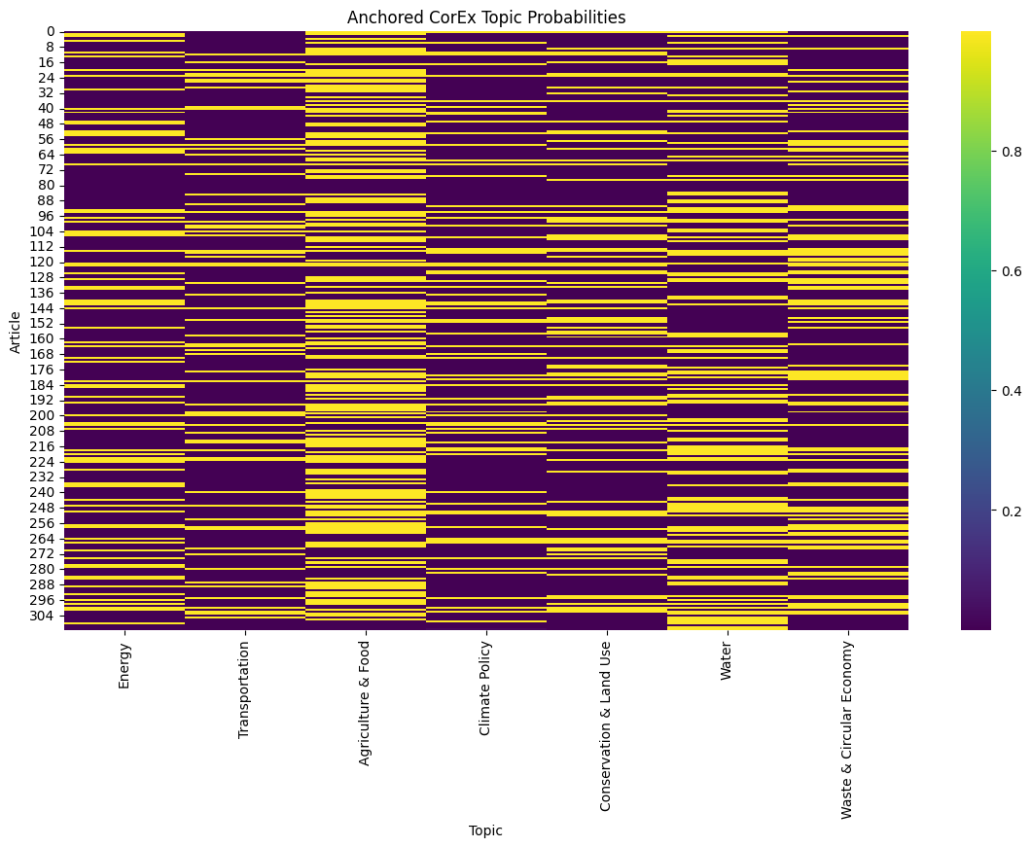
CorEx anchored model
Two sets of seeds
Seed: Topics + keywords from taxonomy
Import Snopes dataset
Remove stop words
Min_df 3
Settings for model fitting
Anchor_strength 5
Seed (topics values+keys)
Training
Inspecting main topics and top words
Visualizing

Slide 19
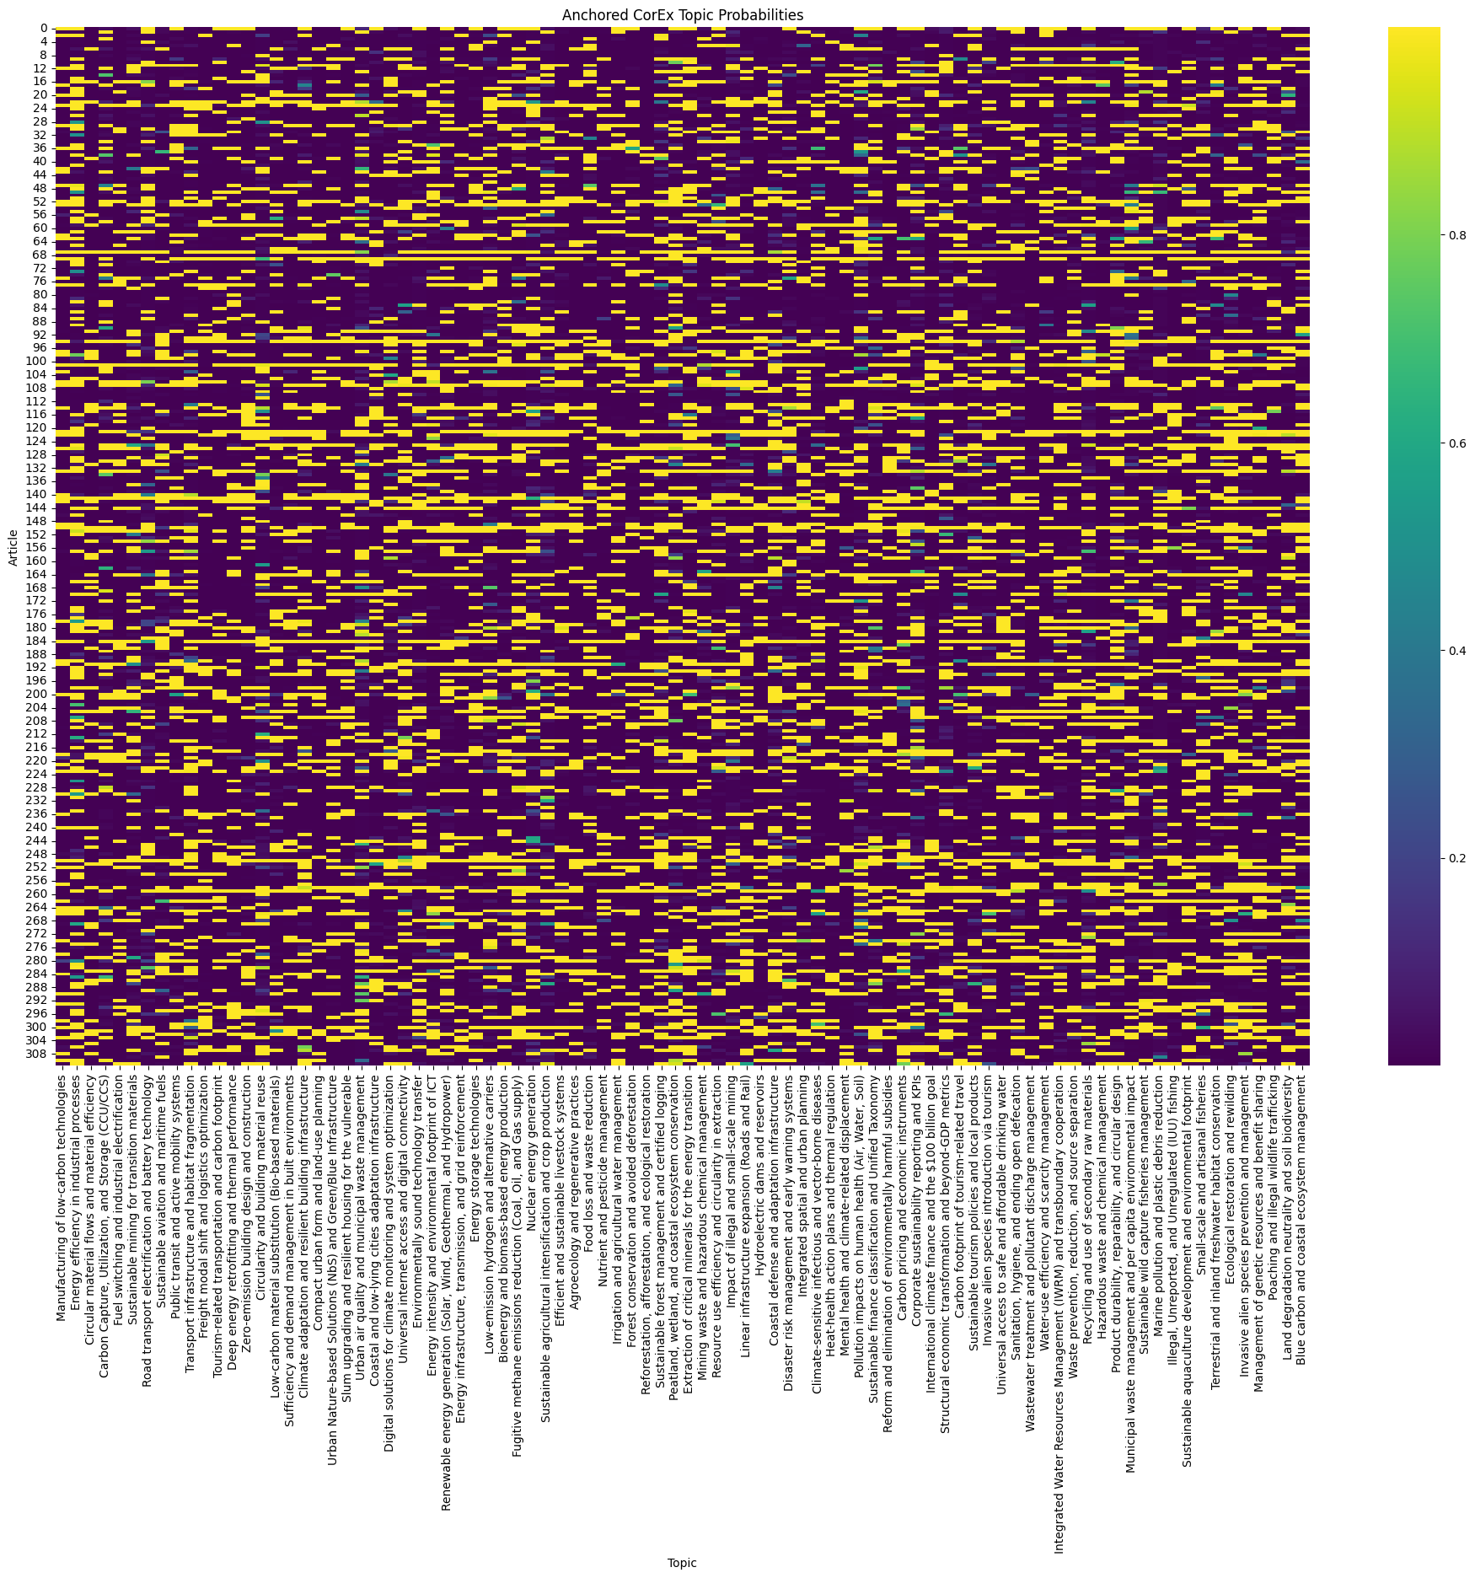
CorEx anchored model
Two sets of seeds
Bad
Complex
Iterative
Good
Chosen themes + words
Generalizable
Insightful results

Slide 20
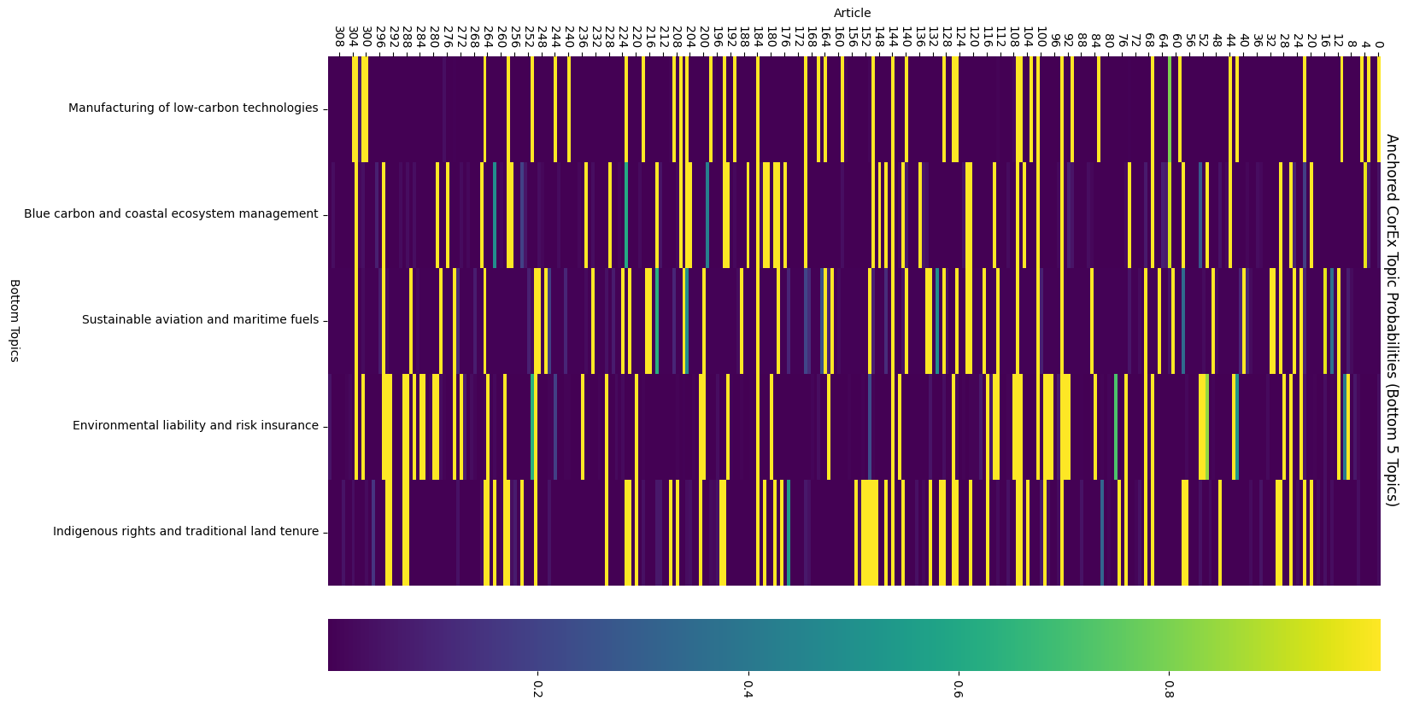
How insightful? (5 least represented topics)

Slide 21
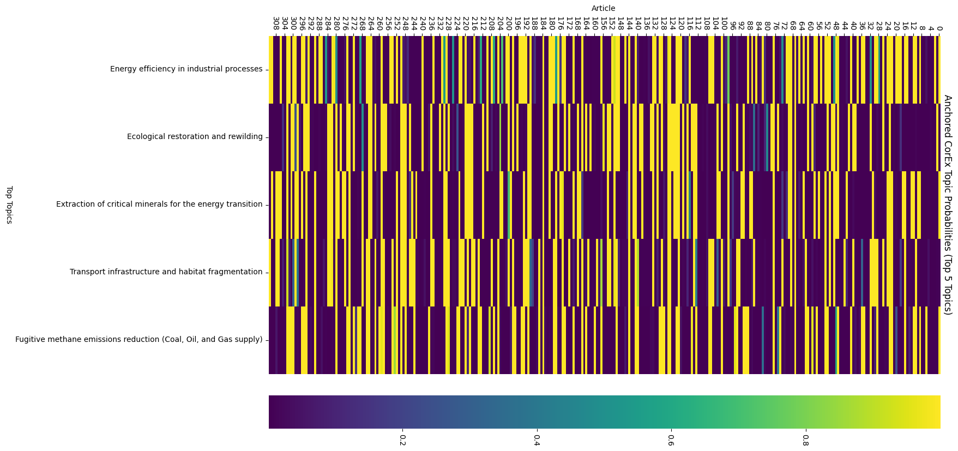
How insightful? (5 most represented topics)

Slide 22


NewsAPI for recent news comparison
Snopes dataset
Last month from index corpus

Slide 23
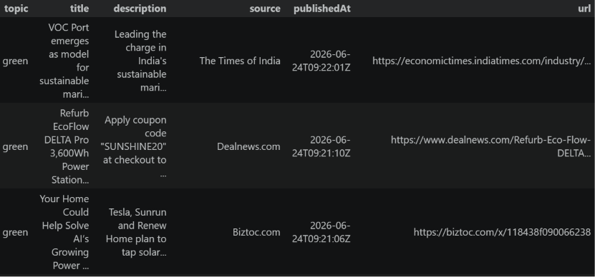
NewsAPI for recent news exploration
Query for recent articles with the theme

Slide 24
Output (PostTreatment_dataset_CorEx.csv)
URL;ArticleText;(Sub-Category);Key NLP words targets;Broad subject;Category / Contentious sector;Category Conceptual Definition;Sub-Category Conceptual Definition;Key interests / key lobbies
Original fake news dataset
Top topic (ML)
Relevant keywords (ML)
Broader category from taxonomy
Context (definitions, key interests and lobbies)

Slide 25
Discussion
BERTopic
CorEx
Insights at the dataset level:
Results: main topics in the data
Exploratory
Directed (zeroshot)
Public: researchers that will train the models (up-river)
Topic density
Systematic bias
Missing data
Distorted parameter estimates
Reduced predictive power
Generalization failure of the model
Insights at the dataset AND individual article level:
Results: main topics in the data and main keywords in the article
Directed (anchored)
Public: researchers AND readers (up-river and down-river)
Same as BERT + Contextual Tags:
Definition of contention topic
Information about lobbies
Complete taxonomy of environmental issues

Slide 26
Limitations (1/3) : Language
Line 81
https://www.wwf.de/aktuell/pinguine-auf-plastikmuellinsel/aufloesung/;Unsere
Entdeckung der Eselspinguine auf der Insel aus Plastikmll ist glcklicherweise nicht echt. Alle gefilmten Pinguine sind wohlauf und leben weiterhin freudig auf ihrer Insel aus Eis. Es handelt sich um eine Bildmontage. Doch wir leben in einer Welt, in der solche Gefahren durch Plastikverschmutzung sehr schnell real werden knnten, daher gibt es keine lustige April-Pointe, sondern einen ernsten Hintergrund.
;;;;;;;

Slide 27
Limitations (2/3) : Partial match
Line 234
http://flbs.umt.edu/;Legacy - We are the second oldest biological field station in the US and the oldest west of the Mississippi River. We have one of the oldest, contiguous lake datasets in the world. Research - We work on a watershed fed by Glacier National Park and other pristine wilderness areas, allowing our research to focus on both natural processes and human-induced effects. Education - We offer premier field-based summer ecology courses, as well as graduate level studies in ecology and limnology. Our students come from across the United States and around the world. Outreach - We feel strongly that science should be disseminated to the greatest number of people, including the local citizenry and the worldwide community. We offer community presentations, expert seminars, and interactive field-based classrooms. Stop by and visit us. We'd love to show you around!;
Sufficiency and demand management in built environments; health, education, areas; Climate;
BUILDINGS AND CONSTRUCTION;
A major focus for energy efficiency and urban adaptation in IPCC AR6 (C.3.4). The EU Taxonomy identifies it as a key sector for climate change mitigation and for the transition to a circular economy through the reuse of building materials,.;Implementation of measures and practices that avoid the demand for energy, materials, and land while delivering well-being within planetary boundaries;
Local authorities, urban planners, behavioral scientists, and civil society organizations

Slide 28
Limitations (3/3) : Only 1st Topic
Line 93
http://www.seriouslyfish.com/species/piaractus-brachypomus/; Piaractus brachypomus Red-bellied Pacu Classification Characidae. Subfamily: Serrasalminae Distribution Native to the Rio Orinoco and Amazon basins in Colombia, Venezuela, Peru, Bolivia and Brazil. Introduced populations are thriving in various parts of the world, mainly in Far Eastern countries such as China and Taiwan where its farmed for eating. Much research is being undertaken to find the most ecologically sound way of farming it, as its suffering from gross overfishing in many of its native waters. If wild stocks become further depleted, there could be serious implications not only for the species itself, but also entire ecosystems. The seeds of many of the fruits eaten by pacu are indigestible, and are excreted intact. Some experts believe the fish play a significant role in seed dispersal of plants from areas of flooded forest. Sustainable commercial farming of pacu is therefore considered a priority. Not only will this prevent further depletion of wild stocks, but it will provide an alternative source of income for farmers. The hope is that it may also encourage them to take up aquaculture instead of agriculture, which is having a devastating effect on many parts of the Amazon rainforest. As a food fish pacu is apparently very tasty. Its natural diet of fruit and nuts is said to enhance the flavour of the flesh. As the fish is so large cuts are often sold on the bone in a similar way to pork ribs. One further commercial use of the species is as a sport fish, both in its natural environment and artificially-stocked lakes. Its been introduced into several Far Eastern countries for this purpose, including Thailand and Malaysia.;
Manufacturing of low-carbon technologies;wrap, states, including;Climate;
INDUSTRY AND MANUFACTURING;
A fundamental pillar of SDG 9 (Sustainable industrialization) and a sector targeted for deep emission reductions by IPCC AR6 (C.3.3),. The EU Taxonomy defines precise technical screening criteria for this sector, particularly for the manufacturing of low-carbon technologies.;Production of specific technologies including renewable energy equipment, low-carbon transport vehicles, and other innovations that contribute substantially to the stabilization of greenhouse gas concentrations in the atmosphere,,.;
Heavy industry manufacturers, engineering firms, renewable energy developers, and industrial technology providers,.

Slide 29
Sources
Gruensteidl, M.N., & Kirrane, S. (2026). A Comparison and Critical Reflection of Information Disorder Detection Techniques: Performing a Cross-Data and Cross-Model Evaluation. Information Fusion, Volume 127, Part B. https://www.sciencedirect.com/science/article/pii/S0950705126000493
Torabi Asr, F., & Taboada, M. (2018). The Data Challenge in Misinformation Detection: Source Reputation vs. Content Veracity. Proceedings of the First Workshop on Fact Extraction and VERification (FEVER), pages 10–15, Brussels, Belgium. https://aclanthology.org/W18-5502/
Torabi Asr, F., & Taboada, M. (2019). Big Data and quality data for fake news and misinformation detection. Big Data & Society, 6(1). https://journals.sagepub.com/doi/full/10.1177/2053951719843310
Farrell, J., McConnell, K., & Brulle, R. (2019). Evidence-based strategies to combat scientific misinformation. Nature climate change, 9(3), 191-195. https://doi.org/10.1038/s41558-018-0368-6
Afzali, M., Colak, G., & Vähämaa, S. (2025). Climate change denial and corporate environmental responsibility. Journal of Business Ethics, 196(1), 31-59. https://doi.org/10.1007/s10551-024-05625-y
Treen, K. M. D. I., Williams, H. T., & O'Neill, S. J. (2020). Online misinformation about climate change. Wiley Interdisciplinary Reviews: Climate Change, 11(5), e665. https://doi.org/10.1002/wcc.665
Essien, E. O. (2025). Climate Change Disinformation on Social Media: A Meta-Synthesis on Epistemic Welfare in the Post-Truth Era. Social Sciences, 14(5), 304. https://doi.org/10.3390/socsci14050304
Walter, N., Cohen, J., Holbert, R. L., & Morag, Y. (2020). Fact-Checking: A Meta-Analysis of What Works and for Whom. Political Communication, 37(3), 350–375. https://doi.org/10.1080/10584609.2019.1668894
Ferracioli, P., Kniess, A. B., & Marques, F. P. J. (2022). The Watchdog Role of Fact-Checkers in Different Media Systems. Digital Journalism, 10(5), 717–737. https://doi.org/10.1080/21670811.2021.2021377
W.E. Forum, The Global Risks Report 2024, Insight Report, World Economic Forum, 2024. ISBN: 978-2-940631-64-3, https://www.weforum.org/publications/global-risks-report-2024/

Slide 30
Q&A
BERTopic (Zeroshot method)
CorEx anchored with 2 sets of seeds
Good
Simplicity
Quick results
Bad
Only themes
No keywords
BERT choices
Bad
Complex
Iterative
Good
Chosen themes + words
Generalizable
Insightful results

Slide 31
Q&A
BERTopic
CorEx
Insights at the dataset level:
Results: main topics in the data
Exploratory
Directed (zeroshot)
Public: researchers that will train the models (up-river)
Topic density
Systematic bias
Missing data
Distorted parameter estimates
Reduced predictive power
Generalization failure of the model
Insights at the dataset AND individual article level:
Results: main topics in the data and main keywords in the article
Directed (anchored)
Public: researchers AND readers (up-river and down-river)
Same as BERT + Contextual Tags:
Definition of contention topic
Information about lobbies
Complete taxonomy of environmental issues

